Slide 1
TTSH-HEAL
Data Science Assignment
By: Enoch Mok

Slide 2
Section 1 [Scenario 2]
There is concern that the experience of the current public transport infrastructure varies significantly across HDB towns.
The Land Transport Authority has tasked your team to assess the current infrastructure, and review if there is merit to accelerate the construction of any specific phase of any MRT line that is due to open before 2030.
*The following maps are interactive, and the html files can be found in ./Section1/report folder

Slide 3
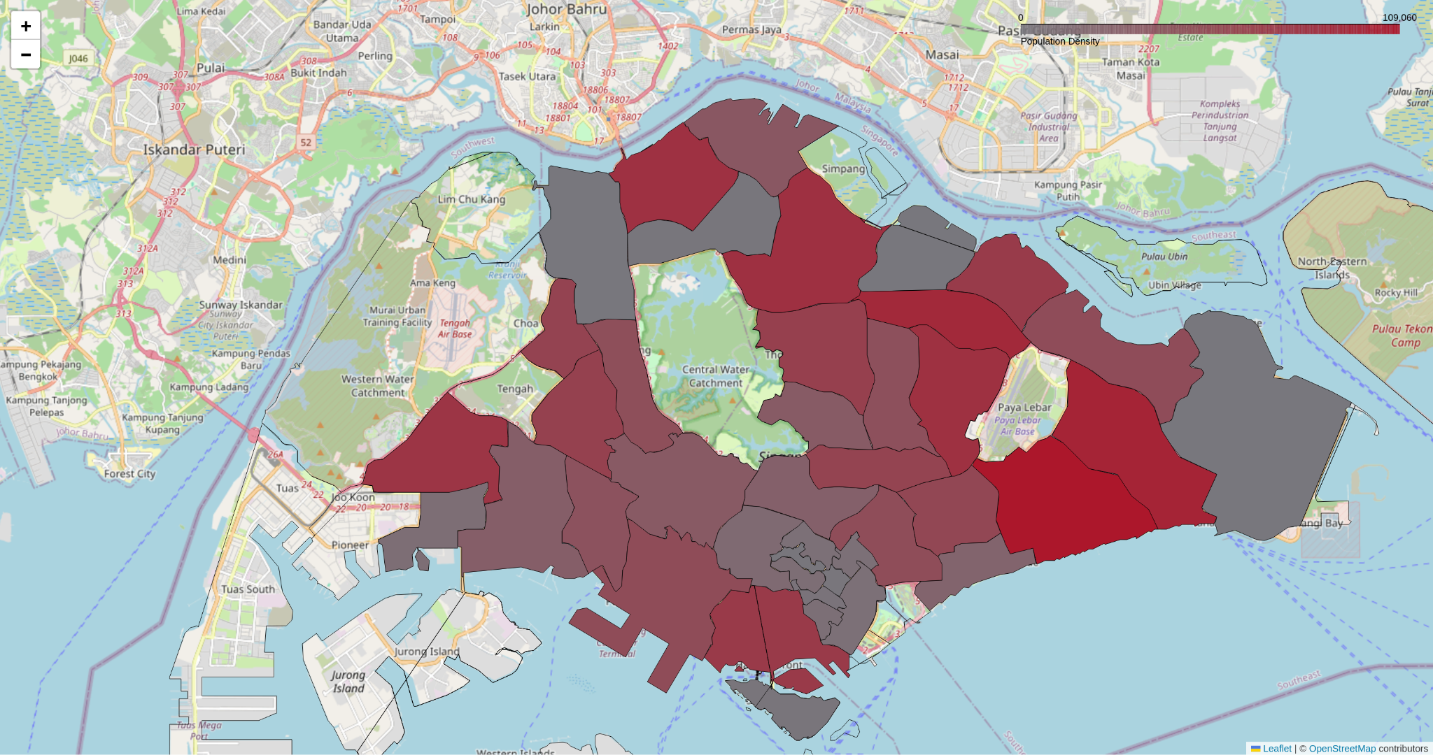
HDB Population Density Heatmap
Grey = Less populated
Red = Very populated

Slide 4
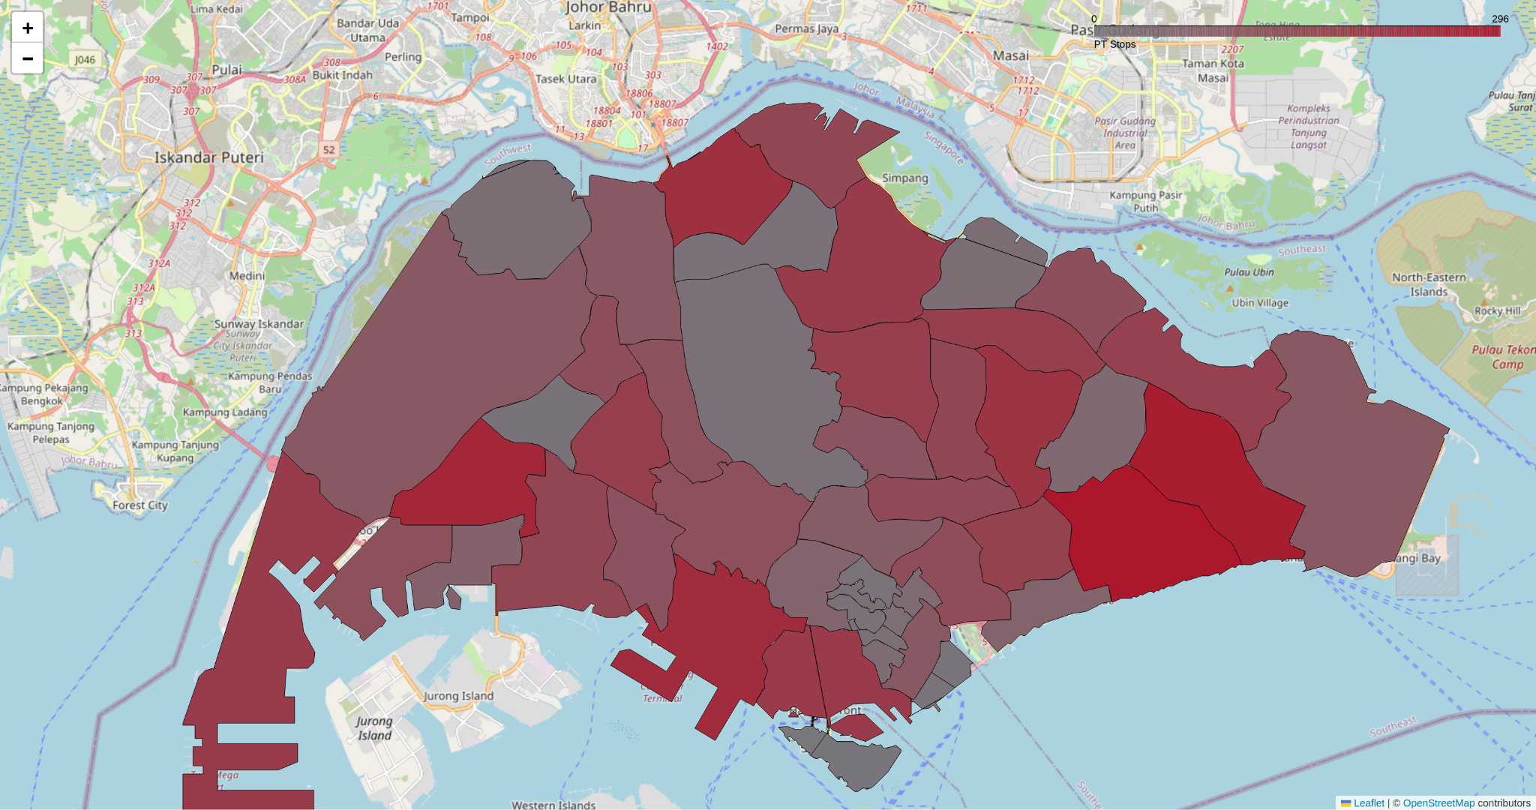
Public Transport (PT) Density Heatmap
Grey = Regions with not many PT stops
Red = Regions with many PT stops

Slide 5
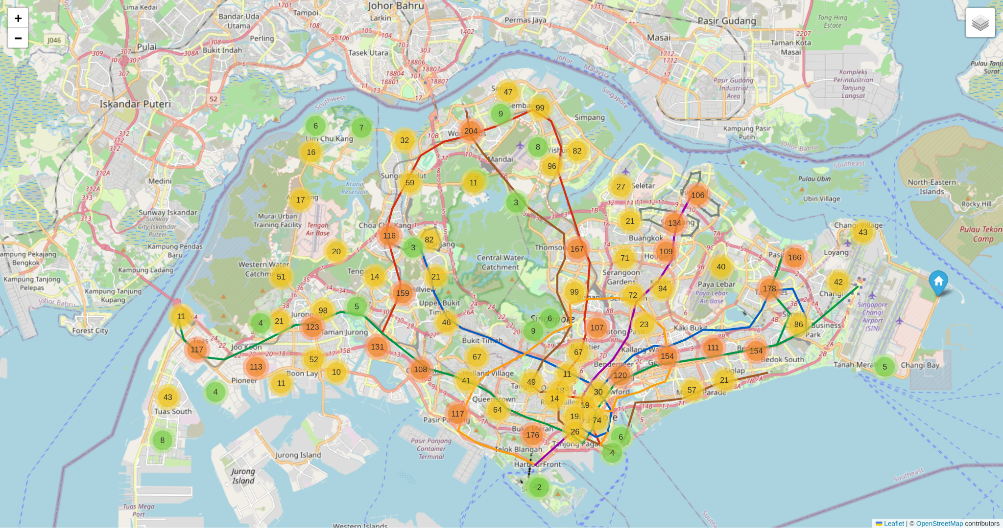
Public Transport Stops (Bus)
The number represents the number of bus stops within that cluster

Slide 6
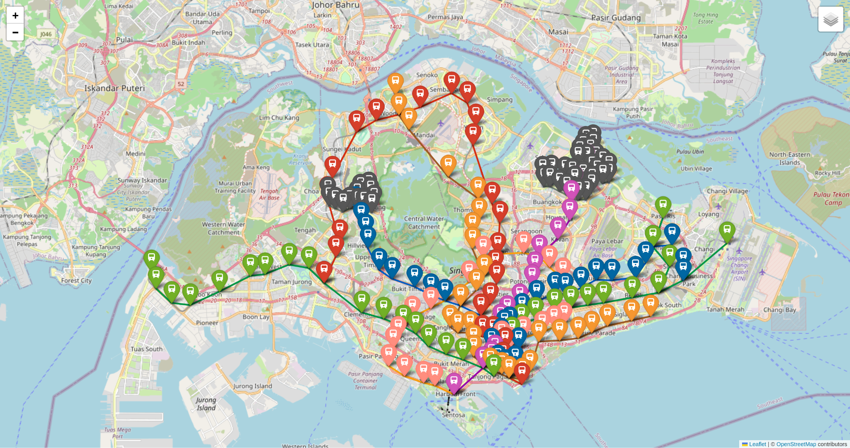
Public Transport Stops (Train)
Map showing the train stops in Singapore

Slide 7
Public Transport (Bus) Density Discrepancy Heatmap
Below shows the top locations that has the highest demand for bus stops
𝑏𝑢𝑠𝑠𝑡𝑜𝑝_𝑑𝑒𝑛𝑠𝑖𝑡𝑦_𝑑𝑖𝑠𝑐𝑟𝑒𝑝𝑎𝑛𝑐𝑦 = (𝑛𝑜𝑟𝑚𝑎𝑙𝑖𝑧𝑒𝑑 𝑝𝑜𝑝𝑢𝑙𝑎𝑡𝑖𝑜𝑛 𝑑𝑒𝑛𝑠𝑖𝑡𝑦 𝑜𝑓 𝑎𝑟𝑒𝑎) - (𝑛𝑜𝑟𝑚𝑎𝑙𝑖𝑧𝑒𝑑 𝑏𝑢𝑠 𝑠𝑡𝑜𝑝 𝑑𝑒𝑛𝑠𝑖𝑡𝑦 𝑜𝑓 𝑎𝑟𝑒𝑎)
Rank | Area | busstop_density_discrepancy
1 | River Valley | 0.3414
2 | Punggol | 0.2707
3 | Sengkang | 0.2377
4 | Choa Chu Kang | 0.1777
5 | Newton | 0.1727

Slide 8
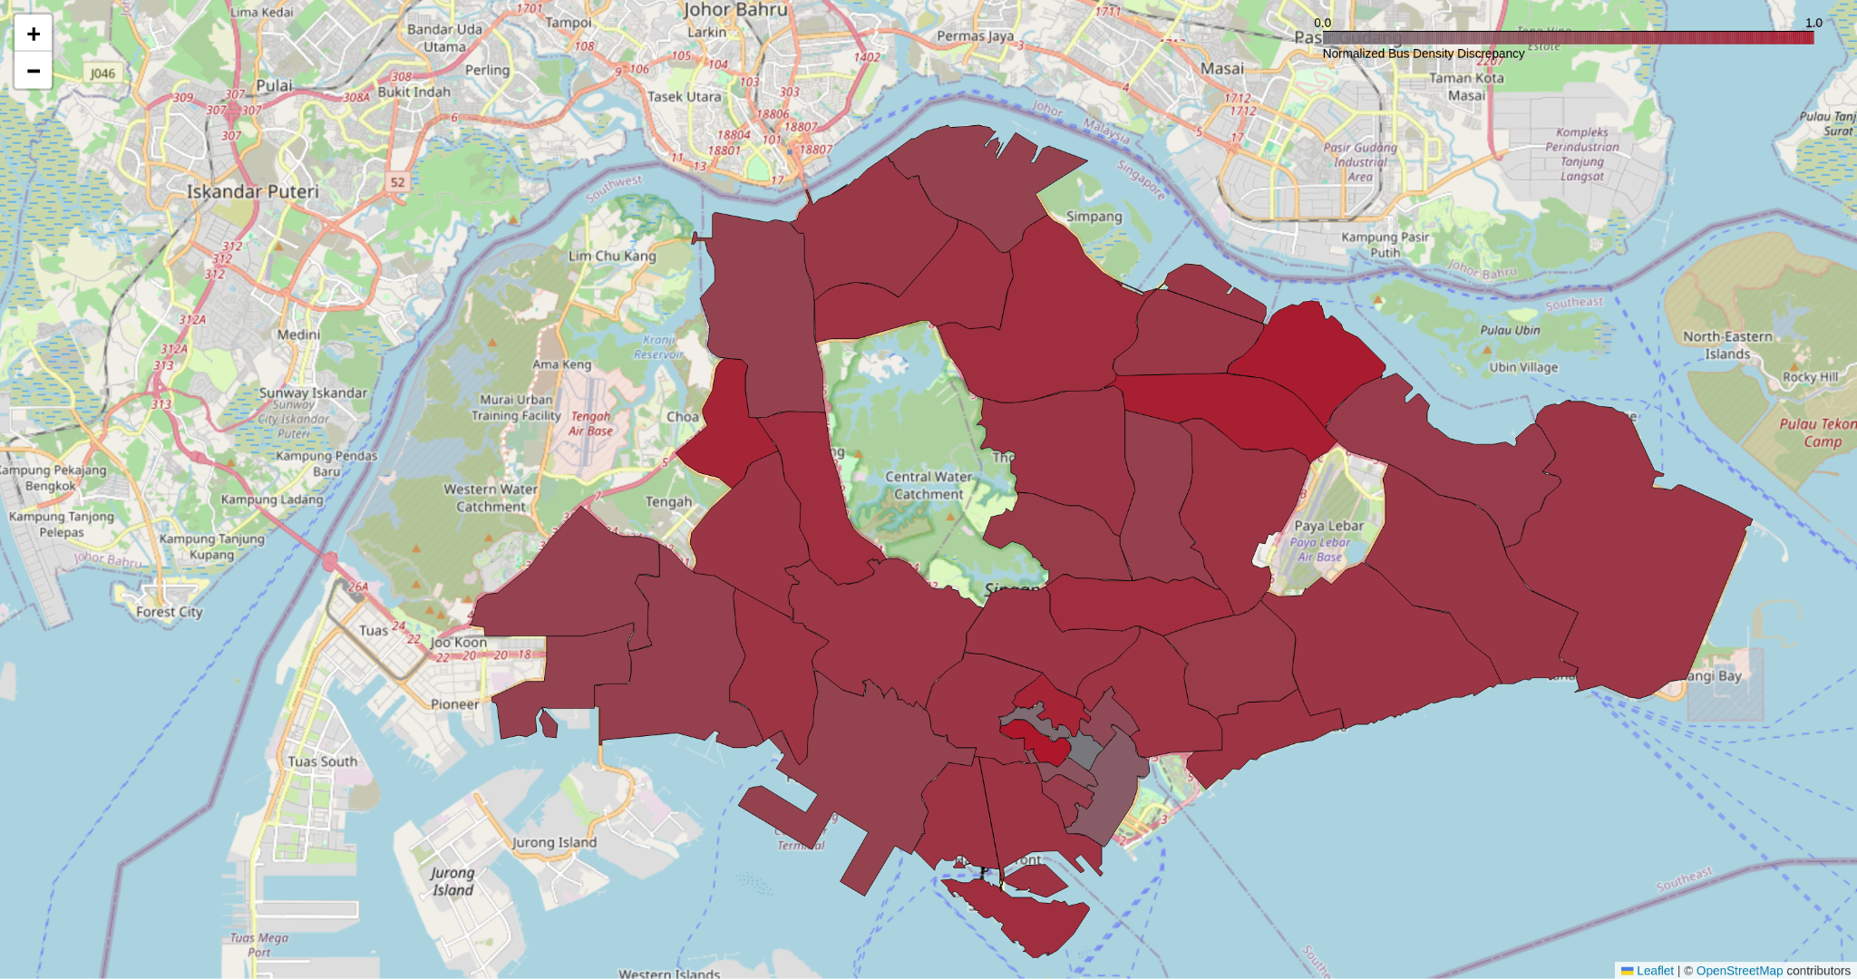
Public Transport (Bus) Density Discrepancy Heatmap
Grey = Regions that do not require more bus stops
Red = Regions requiring more bus stops

Slide 9
Public Transport (Train) Density Discrepancy Heatmap
Below shows the top locations that has the highest demand for train stops
𝑡𝑟𝑎𝑖𝑛𝑠𝑡𝑜𝑝_𝑑𝑒𝑛𝑠𝑖𝑡𝑦_𝑑𝑖𝑠𝑐𝑟𝑒𝑝𝑎𝑛𝑐𝑦 = (𝑛𝑜𝑟𝑚𝑎𝑙𝑖𝑧𝑒𝑑 𝑝𝑜𝑝𝑢𝑙𝑎𝑡𝑖𝑜𝑛 𝑑𝑒𝑛𝑠𝑖𝑡𝑦 𝑜𝑓 𝑎𝑟𝑒𝑎) - (𝑛𝑜𝑟𝑚𝑎𝑙𝑖𝑧𝑒𝑑 𝑡𝑟𝑎𝑖𝑛 𝑠𝑡𝑜𝑝 𝑑𝑒𝑛𝑠𝑖𝑡𝑦 𝑜𝑓 𝑎𝑟𝑒𝑎)
Rank | Area | trainstop_density_discrepancy
1 | Choa Chu Kang | 0.8190
2 | Sengkang | 0.6543
3 | Toa Payoh | 0.6025
4 | Hougang | 0.5640
5 | Woodlands | 0.5396

Slide 10
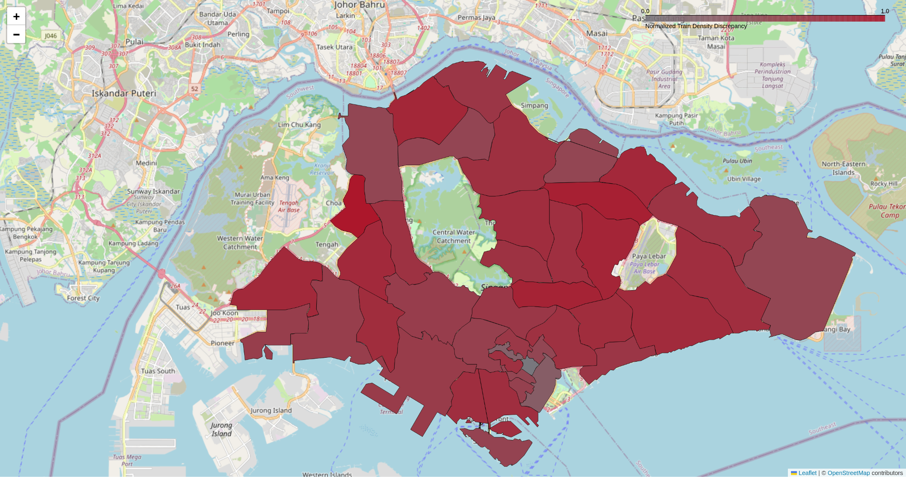
Public Transport (Train) Density Discrepancy Heatmap
Grey = Regions that do not require more train stops
Red = Regions requiring more train stops

Slide 11
Public Transport (All) Density Discrepancy Heatmap
Below shows the top locations that has the highest demand for PT stops
𝑝𝑡𝑠𝑡𝑜𝑝_𝑑𝑒𝑛𝑠𝑖𝑡𝑦_𝑑𝑖𝑠𝑐𝑟𝑒𝑝𝑎𝑛𝑐𝑦 = (𝑛𝑜𝑟𝑚𝑎𝑙𝑖𝑧𝑒𝑑 𝑝𝑜𝑝𝑢𝑙𝑎𝑡𝑖𝑜𝑛 𝑑𝑒𝑛𝑠𝑖𝑡𝑦 𝑜𝑓 𝑎𝑟𝑒𝑎) - (𝑛𝑜𝑟𝑚𝑎𝑙𝑖𝑧𝑒𝑑 𝑃𝑇 𝑠𝑡𝑜𝑝 𝑑𝑒𝑛𝑠𝑖𝑡𝑦 𝑜𝑓 𝑎𝑟𝑒𝑎)
Rank | Area | ptstop_density_discrepancy
1 | River Valley | 0.3457
2 | Sengkang | 0.3405
3 | Choa Chu Kang | 0.3360
4 | Punggol | 0.3296
5 | Newton | 0.1899

Slide 12

Public Transport (All) Density Discrepancy Heatmap
Grey = Regions that do not require more PT stops
Red = Regions requiring more PT stops

Slide 13
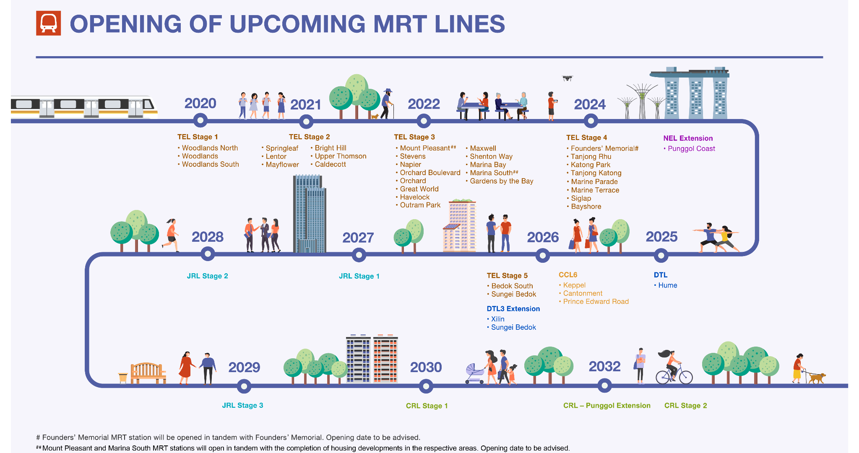
LTA Master Plan 2040

Slide 14
LTA Master Plan 2040
JRL Phase 1 (2027) | JRL Phase 2 (2028) | JRL Phase 3 (2029) | CRL Phase 1 (2030) | CRL Punggol Extension (2032) | CRL Phase 2 (2032)
JS1/NS4/BP1 Choa Chu Kang JS2 Choa Chu Kang West JS3 Tengah JS4 Hong Kah JS5 Corporation JS6 Jurong West JS7 Bahar Junction JS8/EW27 Boon Lay JW1 Gek Poh JW2 Tawas | JE1 Tengah Plantation JE2 Tengah Park JE3 Bukit Batok West JE4 Toh Guan JE5/EW24/NS1 Jurong East JE6 Jurong Town Hall JE7 Pandan Reservoir | JS9 Enterprise JS10 Tukang JS11 Jurong Hill JS12 Jurong Pier JW3 Nanyang Gateway JW4 Nanyang Crescent JW5 Peng Kang Hill | CR2 Aviation Park CR3 Loyang CR4 Pasir Ris East CR5/EW1 Pasir Ris CR6 Tampines North CR7 Defu CR8/NE14 Hougang CR9 Serangoon North CR10 Tavistock CR11/NS16 Ang Mo Kio CR12 Teck Ghee CR13/TE7 Bright Hill | CP1/CR5/EW1 Pasir Ris CP2 Elias CP3/PE4 Riviera CP4/NE17/PTC Punggol | CR14 Turf City CR15/DT6 King Albert Park CR16 Maju CR17/EW23 Clementi CR18 West Coast CR19 Jurong Lake District
Top 5 areas with highest demand for train stops: Choa Chu Kang, Sengkang, Toa Payoh, Hougang, Woodlands
LTA should therefore expedite the following projects:
JRL Phase 1
CRL Phase 1
CRL Punggol Extension

Slide 15
Section 2 [Question 1]
Task: Examine the distribution for number of sales closed by an agent in a year & suggest a probability distribution that may be suitable for modelling this set of values.
What are some ways in which your suggested distribution is appropriate?
What are some of its limitations?

Slide 16
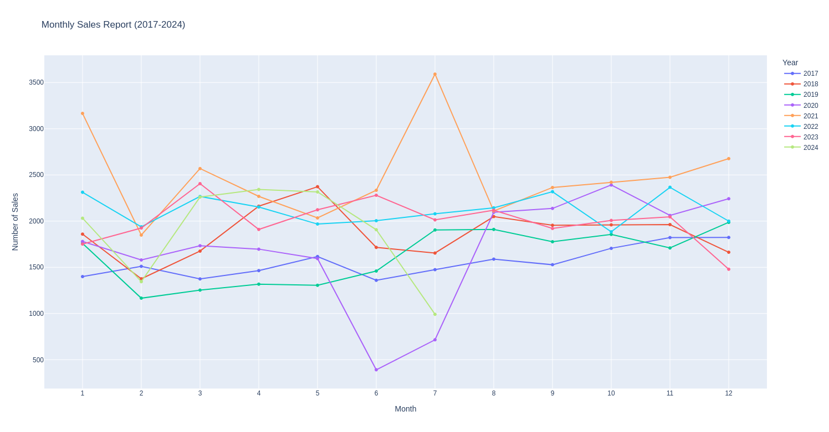
Section 2 [Question 1]

Slide 17
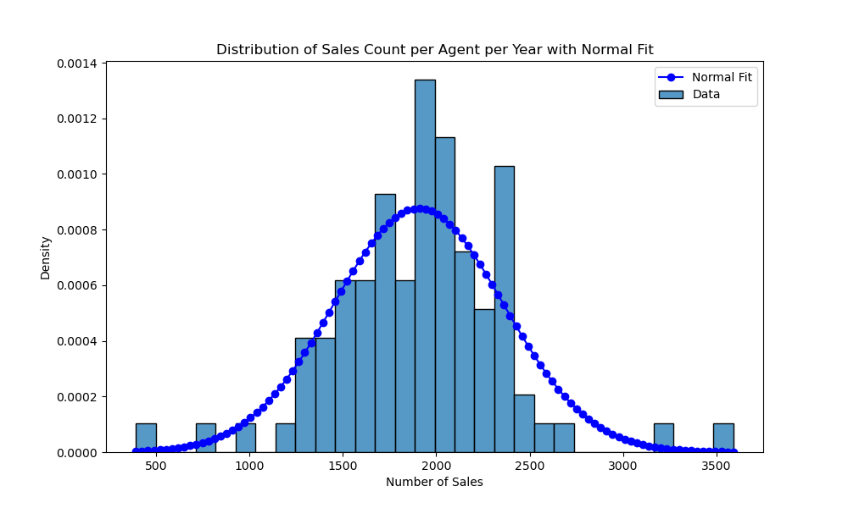
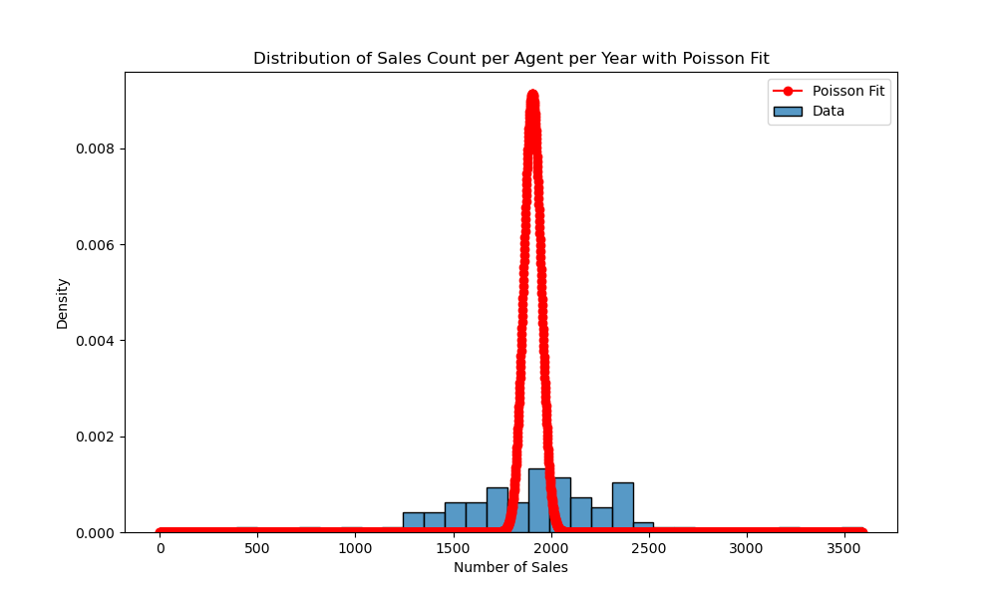
Section 2 [Question 1]
Based on visual interpretation, distribution of sales count seems to follow a normal distribution better compared to Poisson distribution.
This distribution is appropriate because the number of sales count an agent closes is dependent on multiple independent random variables, such as various client preferences, market conditions and economy at that given point of time.
However, if the data has outliers or is skewed, it will not lead to an accurate normal distribution. This can be seen the outliers at the extreme ends of the left graph.

Slide 18
Section 2 [Question 2]
Task 1: From the table, what are some of the information you can deduce for each hotspot?
Task 2: Due to a system error, the location type column for the last 200 rows of the dataset has become garbled. Using all earlier rows as well as all other columns in the dataset, build a classification model to predict the location type for these hotspots. You may treat the three rarest location types as one category.
Task 3: The information has now been recovered from a backup copy of the file. Compared to the true location types, how good was your model? Be prepared to explain the metrics you use to evaluate your model.

Slide 19
Section 2 [Question 2]
Task 1
From each hotspot, the following information can be extracted:
- Location Coordinates (X-coordinate, Y-coordinate)
- Name
- Location Name
- Location Type
- Postal Code
- Street Address
- Operator Name
- INC_CRC
- FMEL_UPD_D

Slide 20
Section 2 [Question 2]
Task 3
Compared to the true location types, my model was able to achieve a much higher mean CV accuracy (0.7350 vs 0.5400)
However, it is heavily skewed towards F&B location, causing bias towards locations in F&B.
This may be due to the data not being shuffled properly, especially towards the last 200 rows.
Hence, when looking at accuracy, it is better to look at the average cross-validation accuracy instead of the accuracy of one round. Cross-validation ensures that the data within the 200 rows are shuffled properly and that the model is trained and tested on all kinds of data that exists in that 200 rows.

Slide 21
Section 2 [Question 3]
Data Characteristics:
1. There are considerably more students from Group X than Group Y in this course of study.
2. Proportionately more students from Group Y are in jobs unrelated to their course of study.
3. The distribution of students among various industries is considerably different between the two student groups.
4. Students from Group X tend to command higher salaries, for the same type of job & industry.
5. The salary differential between the two student groups differs by job nature and industry.
Task: Help your colleague present the insight in an intuitive manner that is easily understood by a non-technical audience, and that reflects as many characteristics in the list as possible. Be prepared to justify any and every aspect of your visualisation (e.g. chart choice, colour palette, labels, orientation, etc.).

Slide 22
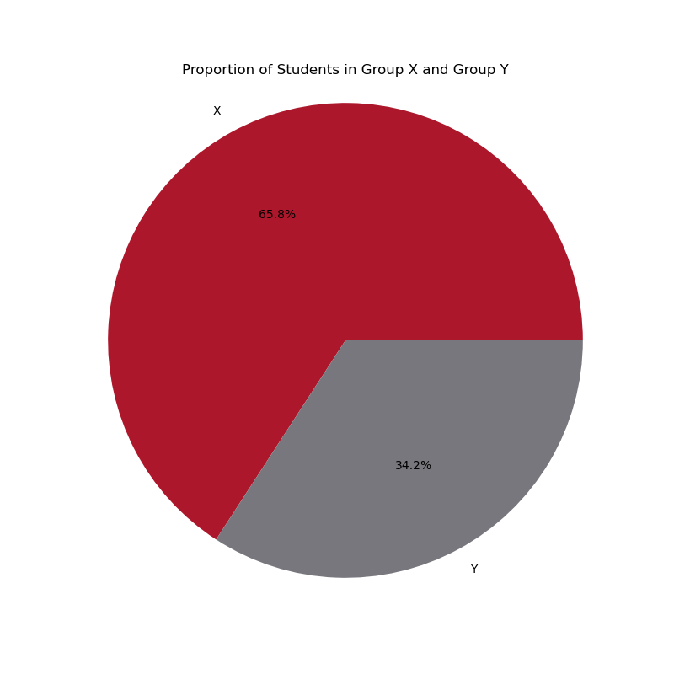
Section 2 [Question 3]
Characteristic 1
There are considerably more students from Group X than Group Y in this course of study.

Slide 23
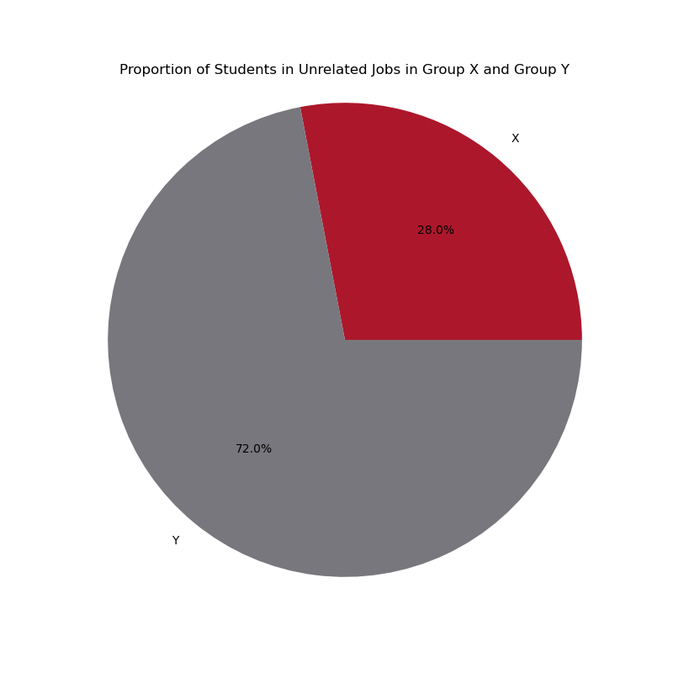
Section 2 [Question 3]
Characteristic 2
Proportionately more students from Group Y are in jobs unrelated to their course of study.

Slide 24
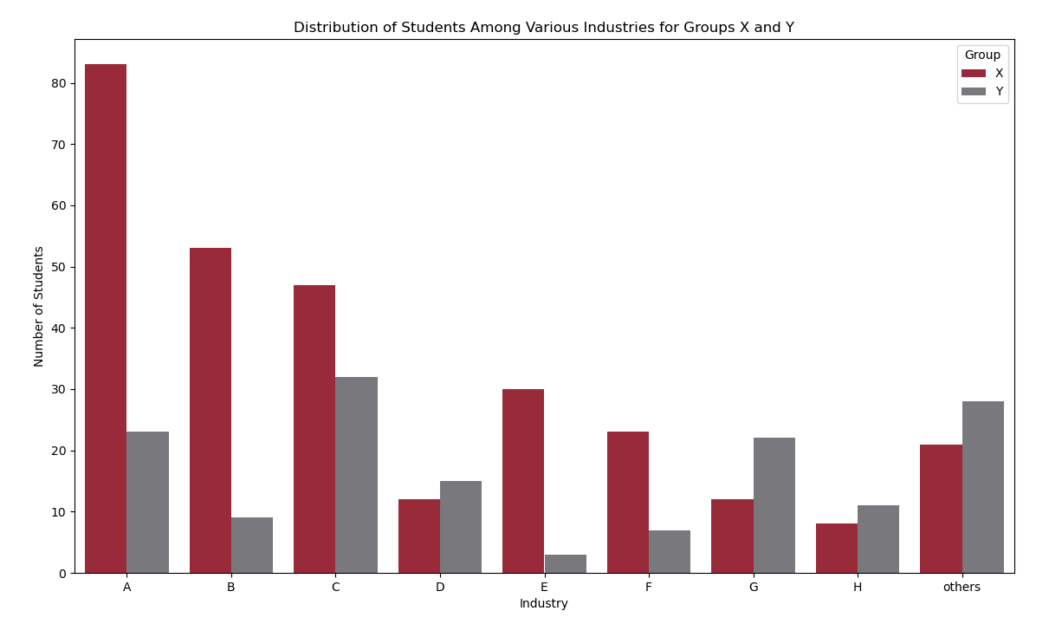
Section 2 [Question 3]
Characteristic 3
The distribution of students among various industries is considerably different between the two student groups.

Slide 25
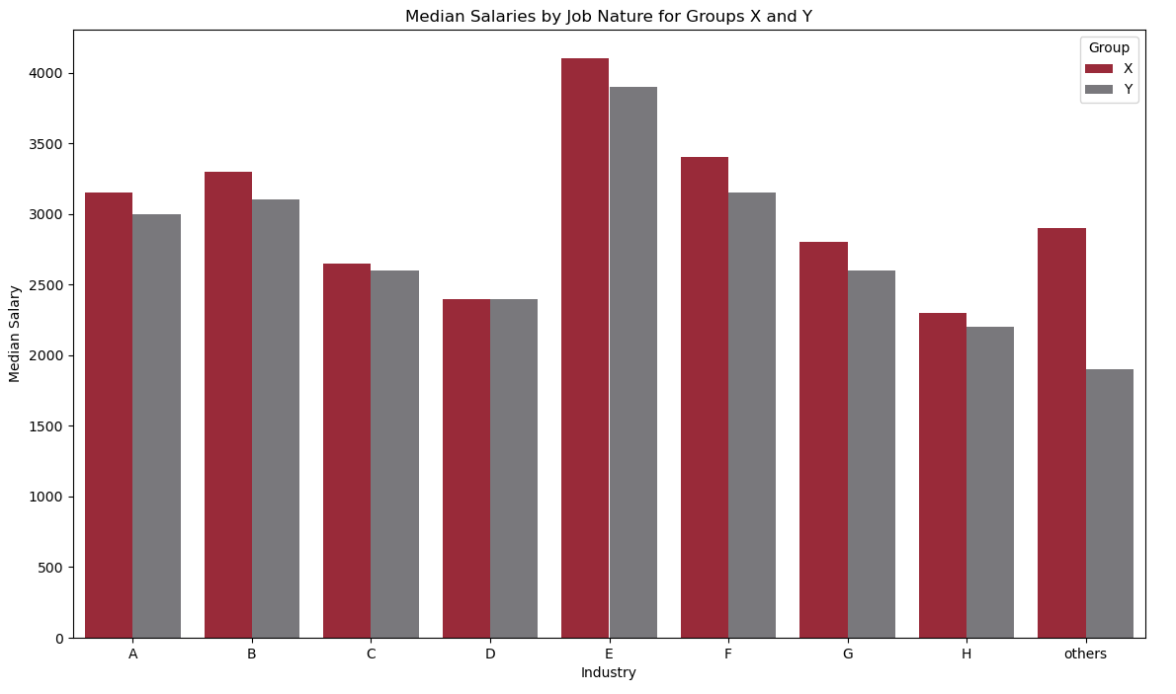
Section 2 [Question 3]
Characteristic 4
Students from Group X tend to command higher salaries, for the same type of job & industry.

Slide 26
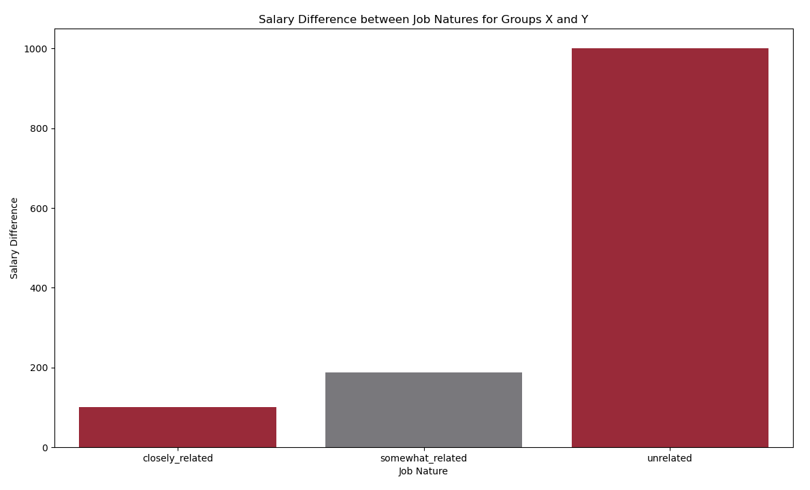
Section 2 [Question 3]
Characteristic 5 (Job Nature)
The salary differential between the two student groups differs by job nature and industry.

Slide 27
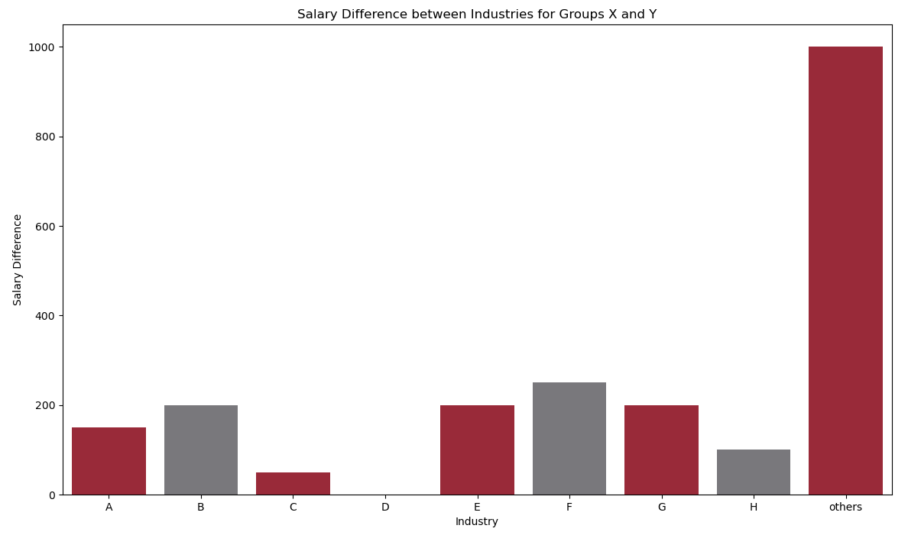
Section 2 [Question 3]
Characteristic 5 (Industry)
The salary differential between the two student groups differs by job nature and industry.

